Slide 1
BOR Update
Doug Podoll
30 January 2015

Slide 2
Tuition Waivers 1
Reciprocal exchange program – A reciprocal program is defined as a relationship between the USG institution and a domestic or international partner institution(s) that involves the exchange of students and/or faculty. USG institutions should work to maintain a balance in the reciprocity element of the exchange. A true one-to-one relationship is not required, but USG participants should be actively participating at the partner institution(s).
Agreements between U.S. government and civic organizations and partner nations and organizations are also eligible for this waiver. Those reciprocal agreements currently are defined as the Fulbright Program, inclusive of Institute of International Education, AMIDEAST, and LASPAU administered programs, the Edmund S. Muskie Graduate Fellowship Program, and Georgia Rotary Student Program students.

Slide 3
Tuition Waivers 2
Non-citizen independent students must provide clear and convincing evidence that they, or their spouse, relocated to the state of Georgia to accept full-time, self-sustaining employment and entered the state in a valid, employment authorized status. The relocation must be for reasons other than enrolling in an institution of higher education and appropriate steps to establish domicile in the state must be taken. The employment upon which the relocation was based must be held at the time the waiver is awarded. Additionally, non-citizen independent students must provide clear evidence that they, or their spouse, are taking legally permissible steps to obtain lawful permanent resident status in the United States.
Waiver eligibility for the above qualifying students may continue provided full-time, self-sustaining employment in Georgia and the employment-authorized status are maintained. Furthermore, there must be continued evidence of Georgia domicile and efforts to pursue an adjustment to United States lawful permanent resident status.

Slide 4
BOR J-1 EV Program
See website for updated forms, etc.
Re-designation
Requires a list of the Board of Regents with their names, addresses, and affirmative statement that they are US citizens and/or Permanent Residents

Slide 5
Instructional Sites in SEVP
Do you have instructional sites in addition to your home campus? Do you have a unique SEVIS number for each? Are you issuing I-20s for each or only under the home campus?

Slide 6
Student Insurance in the U.S.
GRA Insurance
Student Health Insurance Program (SHIP)
United Health Care
Broker Involvement
GaTech has own plan
PGH Global

Slide 7
Study Abroad Insurance
Aiming for 100% participation
6,000 students
Permission to work with broker
Broker will do RFP

Slide 8
Clery Act
4 & 5 March 2015 Workshop ($40)
Led by outside consultant that has seen full report on USG compliance
Also has contract with US Dept. of Education
Will address international issues
Location, location, location
Study Abroad faculty leaders are CSAs: Clery Security Authorities

Slide 9
Business Affairs of Study Abroad
Tentative: Friday, 13 March, MGSC-Macon
9:30 – 3:30
Target Audience
Study Abroad, Accounts Payable, Bursar/Registrar
Topics
Agency Accounts
Tuition: what to charge and who gets it
Budgeting: state funds versus program fees
Etc.

Slide 10
NRA Tax Compliance 1
Sprintax
$1.50 - $2.00 Federal (paid by school)
$24.95 State (paid by student)

Slide 11
NRA Tax Compliance 2
NRA VITA Training--Coastal
Wednesday, 28 January @ GAIE
1 – 4 PM
NRA VITA Training--City
Friday, 13 February @ GaTech
10:00 – 3:00

Slide 12
NRA Tax Compliance 3
GLACIER
System License
Coordinated out of “oneusg” (shared services center)

Slide 13
Archiving Immigration Files
Adjusting state rules to be consistent with federal rules
Others?

Slide 14
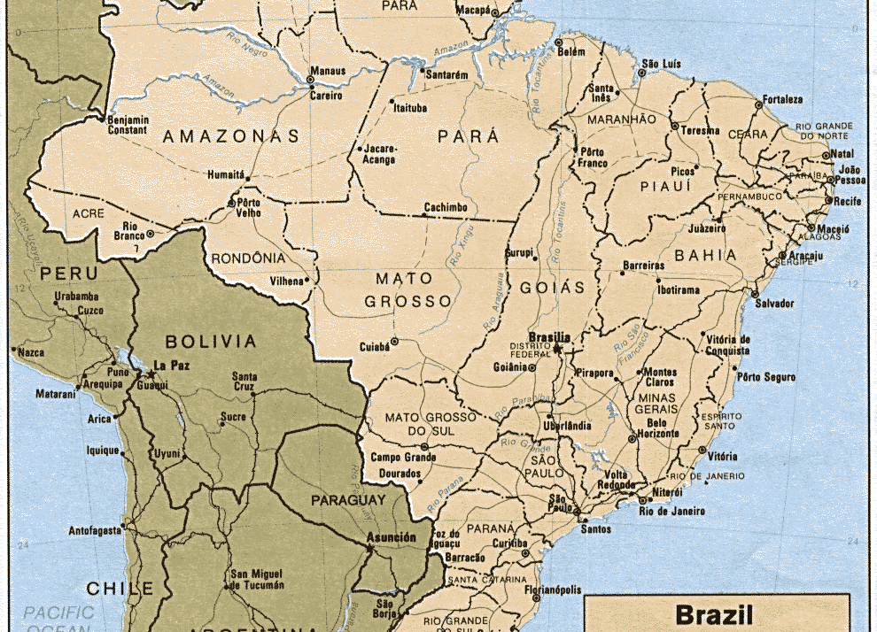
Brazil

Slide 15
CONSOLIDATION
&

Slide 16
Who’s on First?!
Help me with my directory
IIE contact
Int’l Students, Int’l scholars, Study Abroad, ESL
Thank you

