Slide 1
F-1 for Beginners
GAIE Winter Conference 2015
The Journey of Advising Begins

Slide 2
Presented by:
Charlie Hammons
Georgia Tech
International Student Advisor / DSO
Charlie.Hammons@oie.gatech.edu

Slide 3
Topics
DSO Terminology
Issuing the I-20
SEVIS Fee
Gain/Maintain F-1 Status
Enrollment Requirements/RCL
SEVIS Reporting
SEVIS Terminations
Program Extensions
Transfers
Dependents
Travel
Employment Options
Resources/Questions

Slide 4
DSO Terminology
DHS – Department of Homeland Security
CBP – Customs and Border Protection (Port of Entry and Departure)
ICE – Immigration & Custom Enforcement (SEVIS & investigations)
USCIS - Citizenship & Immigration Services (benefit assessment)
P/DSO – Primary/Designated School Official
D/S – Duration of Status
F-1 – The status associated with a degree seeking student issued an I-20
SEVIS – Student & Exchange Visitor Information System

Slide 5
DSO Terminology
I-17 – SEVIS application for school
I-94 – Arrival/Departure record verifying status
I-20 – Certificate of Eligibility
I-515 – Deferred inspection
I-539 – Change of status, Reinstatement
I-765 – Employment

Slide 6
I- 20 Issuance
8 C.F.R. § 214.3(k)
From the student:
Written/Signed Application
Academic Records that meets Admission Standards
Proof of language proficiency
Financial certification (at least 1 year of educational & living expenses)
From the P/DSO:
Student is accepted for enrollment in a full course of study
Must issue form within the U.S.

Slide 7
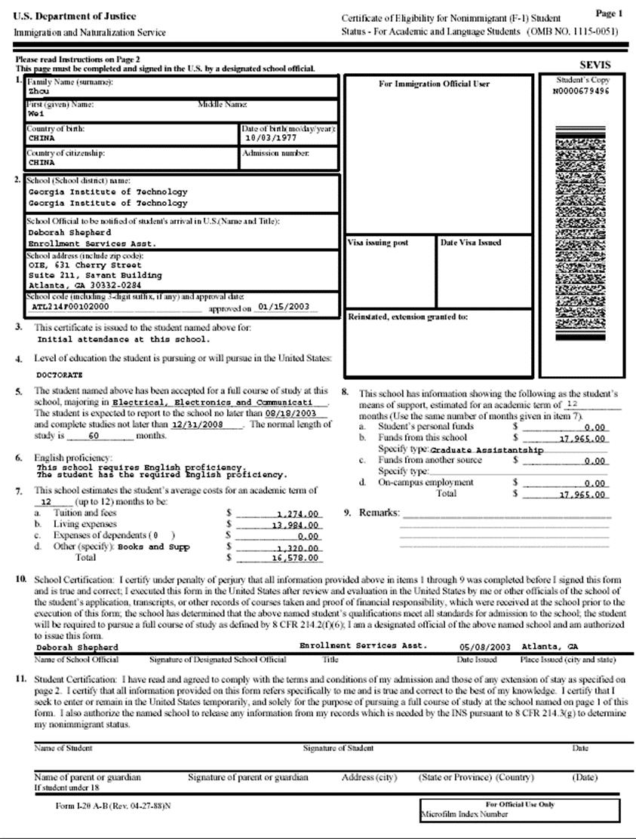
SEVIS number
#4: Level of education the student is pursuing or will pursue in the U.S.
#5: The student named above has been accepted for a full course of study at this school, majoring in:___________. The student is expected to report to the school no later than: (date) and complete studies no later than: (date) . The normal length of study is : ______ months.
#7: Required funding information
#8: Student’s funding information

Slide 8
SEVIS (I-901)Fee
Purpose of the SEVIS fee:
The SEVIS fee is mandated by Congress to support the program office and the automated system that keeps track of students and exchange visitors and ensures that they maintain their status while in the U.S.
The fee is used to:
Maintain and update SEVIS
Hire and train SEVIS Liaison Officers
Staff and manage the SEVP office
Maintain enforcement oversight

Slide 9
SEVIS (I-901)Fee
Who needs to pay?
All prospective F-1 students needing admission at a U.S. POE
Any nonimmigrant in the U.S. applying for a change of nonimmigrant status to F-1 status
An F-1 applying for reinstatement
An F-1 student who has been absent from U.S. for more than 5 months and wishes to re-enter in F-1 visa status.
Who does not need to pay?
A dependent of an F-1 student who will be applying for an F-2 visa
Any F-1 student with continuous F-1 status even when applying for a new visa or transferring schools.

Slide 10
SEVIS (I-901)Fee
Payment Options $200 for F-1 (No CASH):
Country of citizenship or country of birth of Cameroon, Ghana, Kenya, Nigeria or Gambia must pay by money order, Western Union Quick Pay or certified check drawn from a U.S. bank.
All others also have the option to make a credit/debit card payment on www.FMJfee.com
SEVP will also accept third party payments; someone else can pay the I-901 for student’s behalf.
When to pay?
Must be paid at least 3 days before
Initial visa appointment or
Initial entry when a visa is not required (Canada/Bermuda)
Before submitting an I-539 to request a change of visa status to F-1

Slide 11
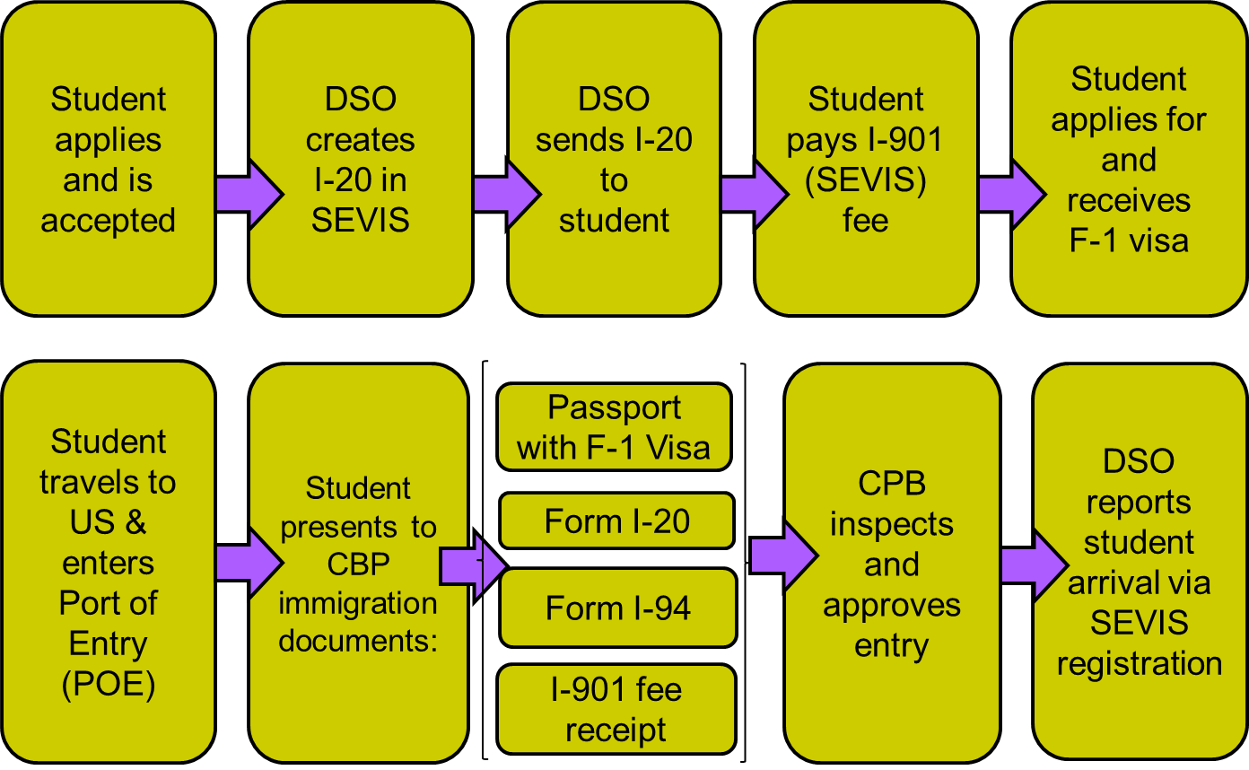
Gain/Maintain F-1 Status

Slide 12
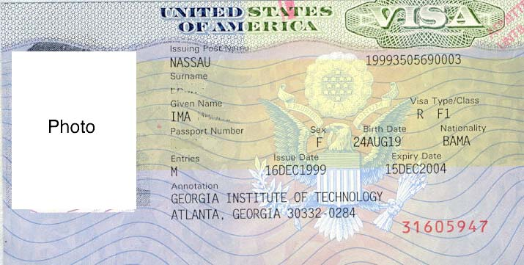
Gain/Maintain F-1 Status
VISA- issued by the US embassy
Number of Entries
Visa Type/Class
Expiration Date
Visa Number

Slide 13
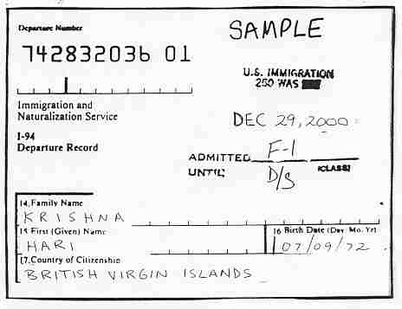
Gain/Maintain F-1 Status
I-94 Arrival/Departure Record
CBP provide a traveler with evidence showing status and time allowed in the U.S with admission stamp that is annotated with date of admission, class of admission and admitted until date.
Electronic record can be obtained www.cbp.gov/I94
Paper I-94

Slide 14
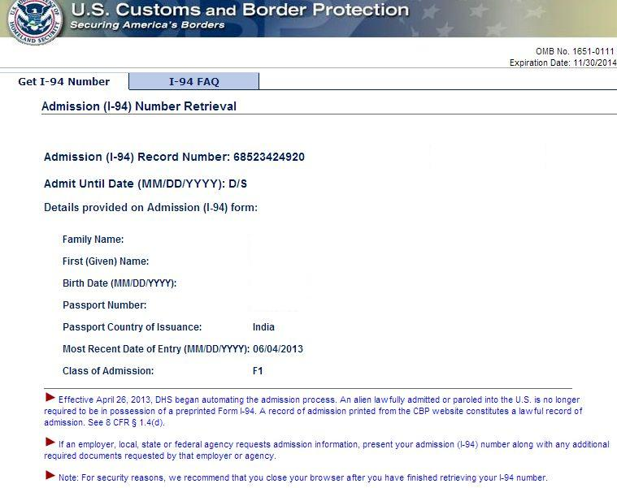
Cbp.gov/i94
Note these!

Slide 15
Gain/Maintain F-1 Status
Port of Entry:
Students may enter no more than 30 days before the program start date on I-20
Customs and Border Protection will
Stamp their passport date of entry, POE, with their admission status (F-1) and duration of their stay (D/S= duration of status)
Students with insufficient documents may be granted a 30 day admission and issued an I-515A form

Slide 16
Maintaing F-1 Status
Check List:
Maintain a valid Passport
Attend authorized school
Complete a full course of study
Make ‘normal’ progress
Update addresses within 10 days
File timely extensions, transfer, change of education level, or change of status
No unauthorized work
Obey state & federal laws
Depart U.S. in a timely manner
Complete program – 60 day grace period
Authorized Early Withdrawal – 15 day grace period
No grace period if there is a violation of visa status
G

Slide 17
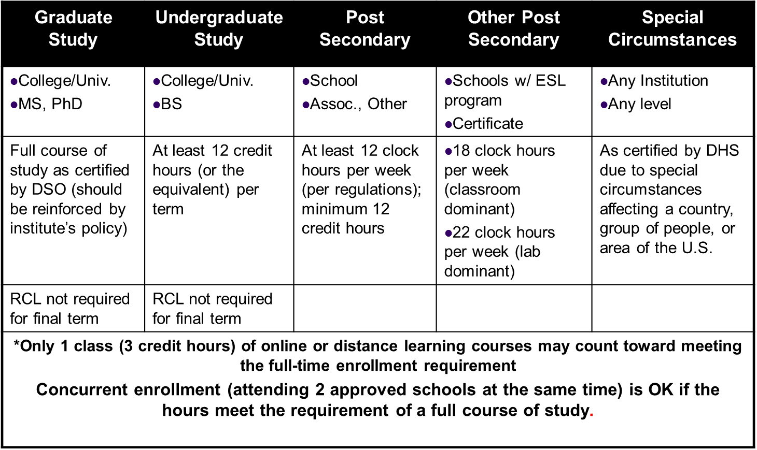
Enrollment Requirements/RCL

Slide 18
Enrollment Requirements/RCL
Exceptions to a Full Course of Study – Reduce Course Load Authorization
The DSO may authorize an F-1 student in advance to engage in less than a full course of study in the following situations
Academic Difficulties
Initial difficulties with English Language
Initial difficulties with reading requirements
Unfamiliarity with American teaching methods
Improper course level placement
Graduation Semester
Degree programs only
Restrictions
Only once per program level
Usually only in first semester

Slide 19
Enrollment Requirements/RCL
Exceptions to a Full Course of Study – Reduce Course Load Authorization
The DSO may authorize an F-1 student in advance to engage in less than a full course of study in the following situations
Medical Conditions
An illness or other medical condition may justify an interruption or reduction in a full course of study
Per recommendation of US licensed practitioner: MD, Doctor of Osteopathy, Clinical Psychologist
Restrictions
May not exceed 12 month total
Possible reduced course load or no course load

Slide 20
Enrollment Requirements/RCL
Exceptions to a Full Course of Study – Reduce Course Load Authorization
The DSO may authorize an F-1 student in advance to engage in less than a full course of study in the following situations
Completing the course of study during final term
Exception not required for graduate or undergraduate levels
Helpful when checking students enrollment if full time is not required
SEVIS authorization is optional
Restrictions
“0” hour enrollment is not an option
Must be enrolled in at least one course with physical presences requirements

Slide 21
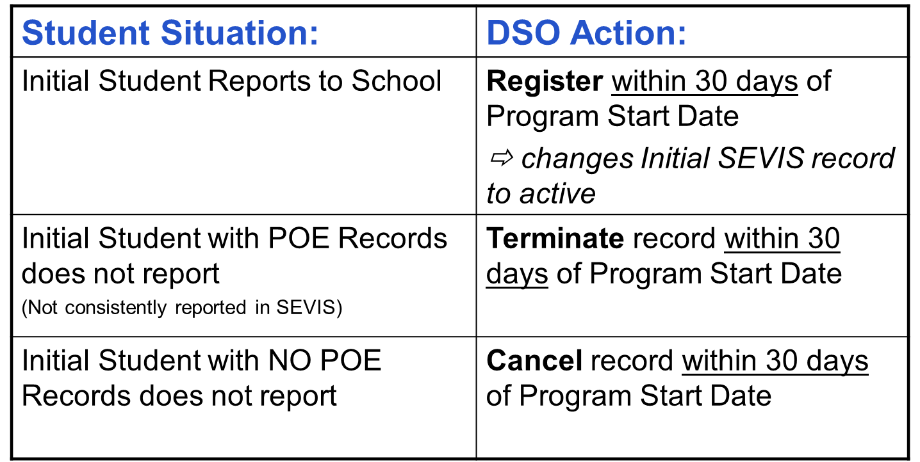
SEVIS Reporting
Initial Students

Slide 22
SEVIS Reporting
Requirements
Periodic (30 days)
Via SEVIS registration
Full-time enrollment
Student’s addresses (local & international)
Current term’s ending date
Start date of next required term
Reduce Course Load Authorizations
Failure to enroll
Event – based (21 days)
Student failed to maintain status
Change in name or address
Completed early
Disciplinary action by school as result of a criminal conviction
Notification request about student’s status

Slide 23
SEVIS Terminations
DSO needs to terminate student SEVIS records when they are in violation of their terms of their status or are no longer in their program due to authorized circumstances
Common termination reasons used by DSO:
No show- manual termination
Otherwise failing to maintain status – with reason
Suspension
Transfer student No Show
Unauthorized drop below full course of study
Failure to enroll
Authorized early withdrawal
Unauthorized withdrawal
Change of status approved (usually updated by USCIS)
It is important to clarify the facts as much as possible before terminating a student’s record
Note: If the violation is one that may be ‘fixed’, the DSO has 21 days to report it to SEVIS.
If a student’s record has been terminated, the student may be able to apply for reinstatement
G

Slide 24
Program Extensions
I-20 Extensions
Student must apply prior to program end date on the I-20
Student has “continually maintained status”
DSO can certify the delay in completion is “caused by compelling academic or medical reasons
Examples: changes of major or research topics, unexpected research problems, or documented illnesses
Student must show new financial documents – documents shows ability to continue financing studies for period of extension
SEVIS reporting: new end date and explanation
Issue a new I-20 with the extension of up to 12 months
Multiple 12-month extension can be done back to back if necessary.
Extensions can not be granted when the student is not completing on time due to poor academic performance

Slide 25
Transfers
Must be transferring from/to a DHS approved school
Classes at the transfer-in school must begin within 5 months of completing classes at the transfer out school or ending OPT employment
Student must be fully accepted and SEVIS release completed within the 60-day grace period
Good practice to request documentation of admission before releasing SEVIS record
Some schools will not assist with reinstatement application
Check with transfer-in DSO before releasing the SEVIS record of a student who violated status.

Slide 26
Dependents
A spouse or child (unmarried minor under age 21).
Update financial section of F-1’s SEVIS record to show increase of expenses
Generate new I-20 for primary
Generate I-20(s) for dependent(s)
School’s are not required to verify relationship (might be required for visa or change of status applications)
Status is dependent upon principal’s status
Dependent CANNOT accept employment or study

Slide 27
Travel
Obtain valid travel signature (12 month validity)
Valid Visa
Except for visa waiver and automatic revalidation
Valid Passport – 6 months validity into the future
Students on Post-Completion OPT
EAD
Proof of employment (job offer letter)
Travel signature (6 month validity)
F-2 Travel
Temporary Absence: 5 months or less
Exceptions:
Enrolled for study abroad or research abroad
Approved leave of absence
Non-Temporary Absences: 5 months or more
Requires a new initial I-20

Slide 28
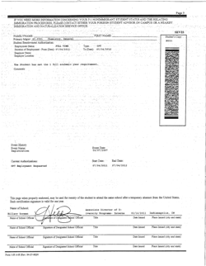
Travel Signatures

Slide 29
Travel
Automatic Visa Revalidation
If student travel for less than 30 days solely to Canada, Mexico, or adjacent islands in Caribbean (except Cuba)
The expired F visas are considered to be “extended” to the date of re-entry (eliminating need to obtain new visa at U.S. consulate before reentry)
Only available when the following conditions are met:
F nonimmigrant is not national of one of the countries identified as supporting terrorism in DOS ( Iran, Syria, Sudan, Cuba)
F non immigrant satisfies the following:
Maintained and intends to resume F status and is reentering prior to expiration of program
Present valid I-20 with valid travel signature, possess valid passport, and unexpired I-94
Has not applied for a visa while abroad

Slide 30
Employment Options
On Campus or DSO Authorized
On Campus
No special authorization is needed
Students may work on campus up to 20 hours/ week while classes are in session
During official breaks and over summer (if not enrolled), Full-time employment is permitted
Off Campus w/ DSO Authorization
All off-campus employment requires specific authorization from DSO or USCIS
Curricular Practical Training (CPT)
Internship
Co-op
An I-20 is issued with CPT employment authorization
Employment is an “integral” part of student’s program of study

Slide 31
Employment Options
USCIS Authorized
Optional Practical Training (OPT)
Related to students major-appropriate to level of study
Pre-completion
20 hours/week or full-time during breaks
May require multiple applications and fees
Post completion
At least 20 hours/ week, paid or volunteer
Cap Gap OPT extension –H1B filed before OPT EAD expires – documented with new I-20
STEM extension – specific majors, new application required
Severe Economic Hardship
Unforeseen Circumstances
Due to no fault of the student

Slide 32
Resources/Questions
NAFSA: www.nafsa.org
GAIE: http://gaieinfo.blogspot.com/
ICE SEVIS pages: www.ice.gov/sevis
Travel information: http://www.ice.gov/sevis/travel/faq_f.htm
Study in the States (DHS): http://studyinthestates.dhs.gov
Custom and Boarder Protection (CBP): www.cbp.gov
Charlie Hammons Charlie.Hammons@oie.gatech.edu

