Slide 1
Bilateralism, Admissions, & Academics
Eric Spears, Georgia College
Julie Strecker, Mercer University
Ray Tatum, Brenau University

Slide 2
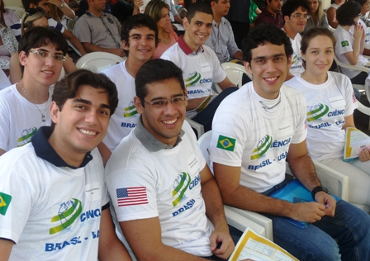
Objectives:
Review how to partner with BSMP
Explain the admissions process
Discuss various academic programs, including ESL prep courses

Slide 4
http://world-economic.com/uploads/foto_article/article_09_2013_bricsic_1.jpg

Slide 6
BSMP Partnership: http://www.iie.org/Programs/Brazil-Scientific-Mobility

Slide 7
ADMISSIONS
Common Application is a required
Decision-maker --- who actually does the admission?
IELTS / TOEFL
5-day turnaround time
TOA (Terms of Agreement)

Slide 8
Academics STEM Subjects & ESL
Orientation
Placement
Courses
Reporting to IIE
Communication
Support Services

Slide 9
Thank you! Obrigado!
Eric Spears: eric.spears@gcsu.edu
Julie Strecker: Strecker_jl@mercer.edu
Ray Tatum: rtatum@breneau.edu

